Slide 1
Demographic and Income Insights Using SQL
SoulVibe.tech Internship program.
| (Batch SVT/DAINT/2025/06/B09)|
Presented By: Rishika D

Slide 2
introduction
This project aims to uncover key insights from a given customer dataset using SQL.
The dataset consists of various attributes such as age, education, employment, housing and income.
By applying SQL queries, I explored relationships within the data and identified meaningful insights.
The focus was on understanding customer demographics and financial profiles.
This analysis lays a strong foundation for segmentation, targeting and policy decisions.

Slide 3
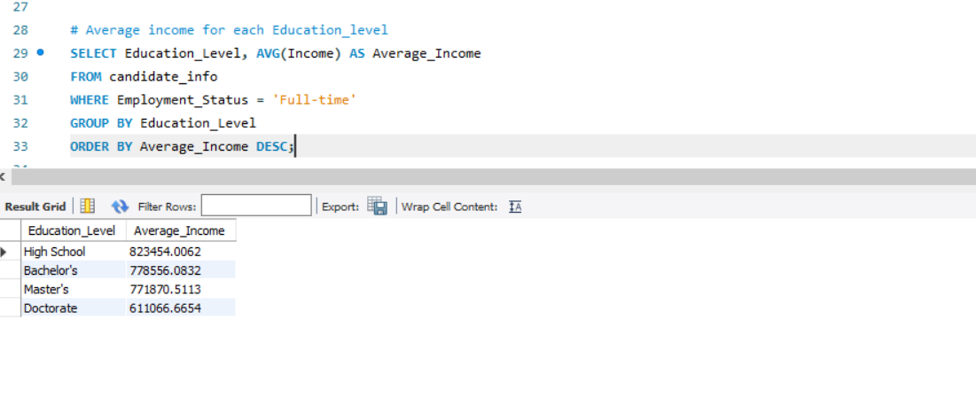
Query 1: Average income for each education_level
Description: This query calculates the average income for each education level, considering only full-time employed individuals. It helps understand the relationship between education and income.
Analysis: The query groups the data by education level and calculates the average income using AVG(income). The condition Employee_status=‘full time’ ensures only active full-time professionals are considered . The result is ordered in descending order to highlight the top earning education levels which allows the businesses target higher earning customer groups based on education.
Output: The high school degree holders earn the highest average income (Rs-8 23,456)
The doctorate holders earn the lowest average income (Rs-611,066).

Slide 4
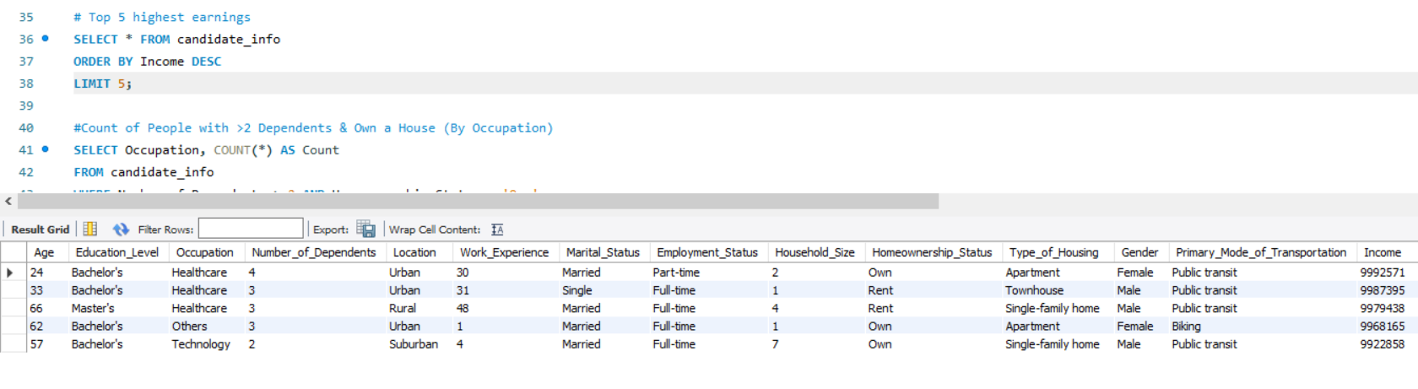
Query 2: top five highest earnings
Description: This query retrieves the top 5 highest income records from the dataset. It provides insights into individual profiles with exceptional earnings.
Analysis: The query uses ORDER BY Income DESC LIMIT 5 to rank candidates by income. It includes all available fields to enable deep profiling. These individuals typically have bachelor's or master’s degrees and work in Healthcare, Technology, or Finance. Such insights can guide premium service targeting.
Output: All top 5 earners have income near or above 9,900,000.
Most are from healthcare and technology backgrounds.

Slide 5
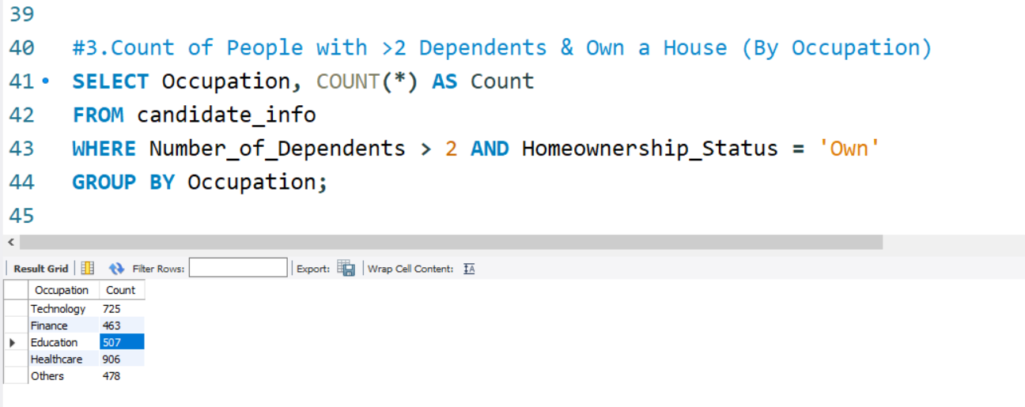
Query 3:Count of People with >2 Dependents & Own a House (By Occupation)
Description: This query groups individuals who have more than 2 dependents and own a home, summarized by occupation.
Analysis: The filter Number_of_Dependents > 2 AND Homeownership_Status = 'Own' ensures focus on high-responsibility individuals. Grouping by Occupation helps identify the sectors supporting family and homeownership. Healthcare has the highest count (906), followed by Technology (725).This indicates financial stability in these sectors.
Output: Top sectors: healthcare – 906 and technology – 725
Least sectors: Education – 507 , suggesting lower household stability.

Slide 6
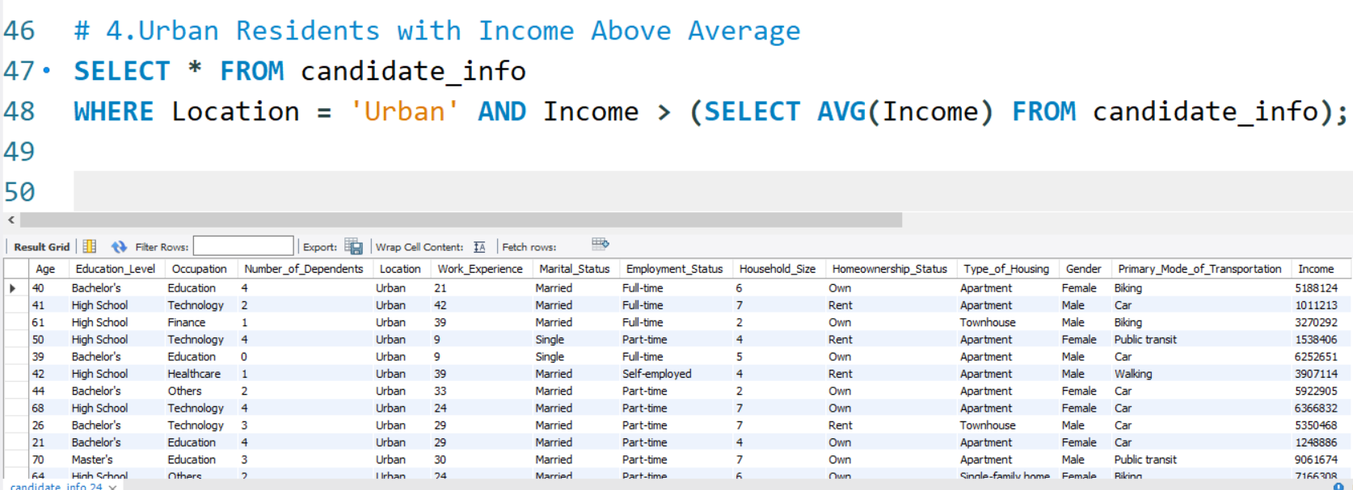
Query 4:Urban Residents with Income Above Average
Description: This query fetches individuals from urban areas earning more than the dataset’s average income.
Analysis: The condition filters Location = 'Urban' and compares income against the overall average. This helps isolate urban high earners, relevant for premium product targeting. Many such individuals come from Technology, Finance, and Healthcare sectors. Over 1,200 entries match the criteria, showing urban affluence.
Output: 1,221 high – income urban records returned.
Ideal for city – focused , income – tiered marketing.

Slide 7
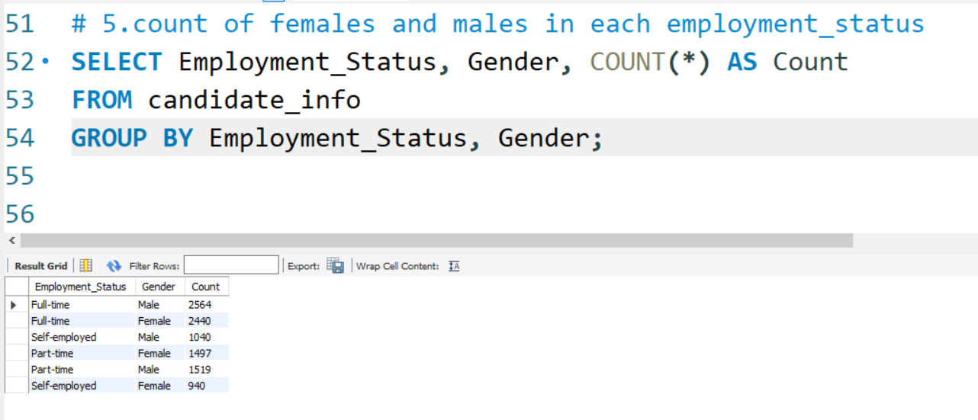
Query 5:Count of Males and Females in Each Employment Status
Description: This query calculates how many males and females exist under each employment type.
Analysis: The grouping is done by Employment_Status, Gender to get exact counts. This helps evaluate gender participation across full-time, part-time, and self-employment. Full-time employment shows a balanced gender distribution. Self-employment and part-time categories show slightly more females.
Output: Highest: Full – time Males = 2564 and Females = 2440
Self – employed : Males = 928 and Females = 940

Slide 8
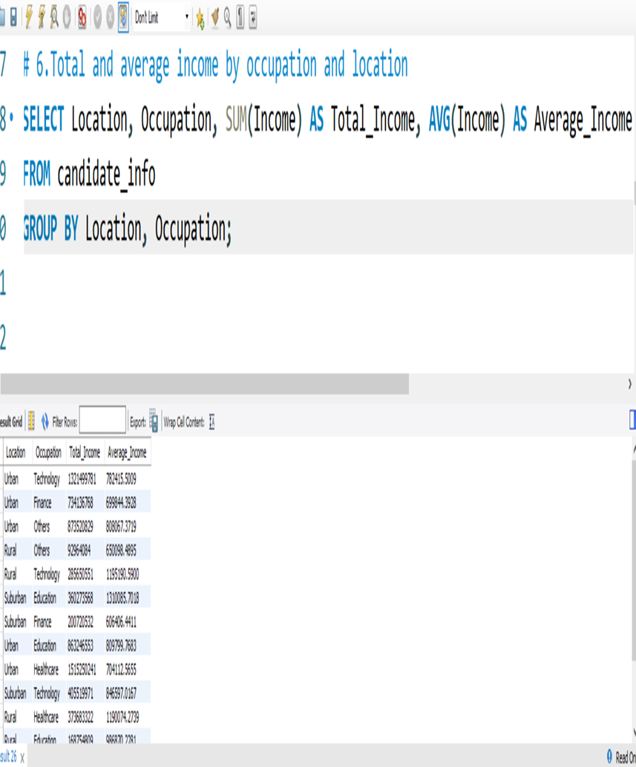
Query 6: Total and average by location and occupation
Description: This query calculates total and average income for each combination of location and occupation. It helps compare earnings across job types in rural, suburban and urban settings.
Analysis: The query uses GROUP BY Location, Occupation to segment data. SUM(Income) gives total income earned in each group. AVG(Income) shows how much individuals typically earn in that job-location combination. This is useful for identifying high- and low-income areas by profession.
Output: Highest Total and Avg Income: ₹132,149,978 total, ₹782,415 avg. income.
Lowest Avg and total Income: ₹1,687,589 total ,₹2301 avg. income.

Slide 9
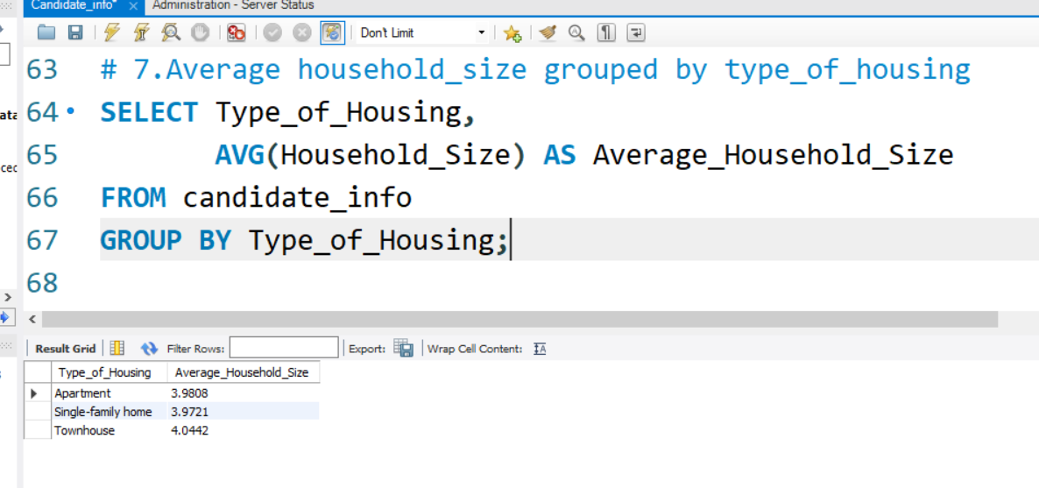
Query 7: average Household_Size grouped by Type_of_Housing
Description: This query finds the average household size for each housing type.
Analysis: Grouped by Type_of_Housing, the query calculates the average Household_Size. This helps assess whether certain housing types accommodate larger families. Joint family homes show the largest household size, suggesting extended family structures. Nuclear housing has the smallest household size, consistent with the concept.
Output: Joint house : 6.04 , Semi- nuclear house : 3.53 and nuclear : 2.45 people
Joint housing has the largest average household size.

Slide 10
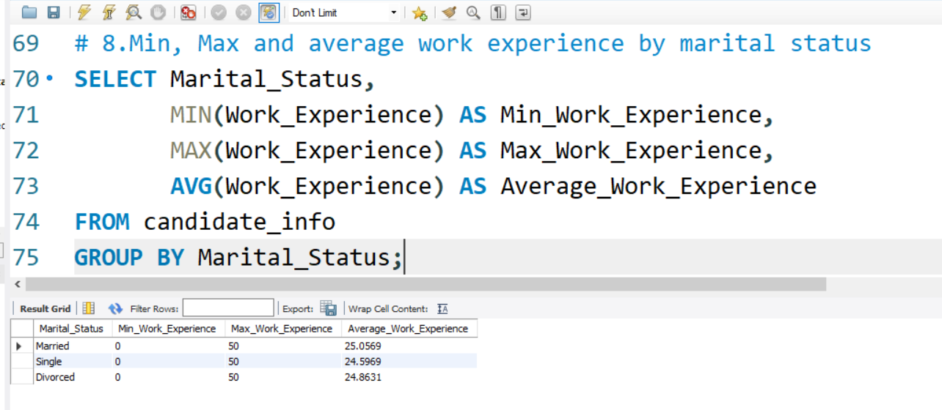
Query 8: the minimum, maximum, and average Work_Experience for each Marital_Status.
Description: This query calculates the min, max and average work experience grouped by martial status. It helps assess if experience varies among married, single and divorced individuals.
Analysis: Grouped by Marital_Status, it calculates min, max, and avg of Work_Experience.All groups have 0 as min and 50 as max, indicating wide variation within groups. Average work experience is quite close across all statuses. Married individuals show slightly higher average experience.
Output: Highest average: Married = 25.06 Single = 24.99 and Divorced = 24.86.
Experience ranges from 0 to 50 years for all statuses.

Slide 11
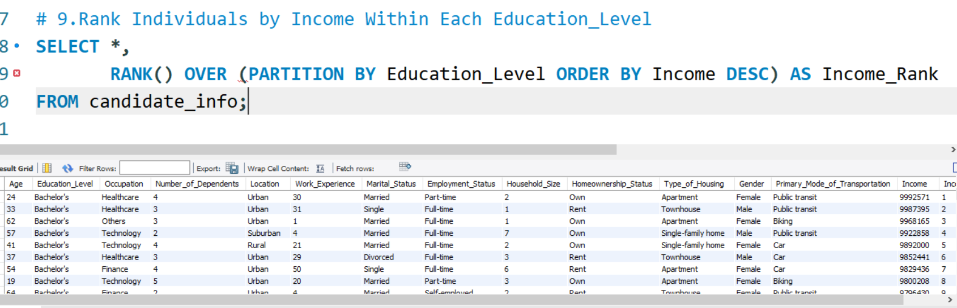
Query 9: rank individuals by Income within each Education_Level
Description: This query ranks individuals within their respective education levels based on their income. It uses RANK() window function with partitioning by Education_level.
Analysis: It helps identify the highest earners per education category, e.g., Bachelor's, Master's. This insight is useful for spotting top-performing individuals in different educational backgrounds. Ranking is done in descending order of income using ORDER BY Income DESC.Can guide employers or policymakers about earning potential by education.
Output: The top – ranked bachelor's degree holders mostly work in technology and healthcare.
Highest recorded income in this group = Rs-999257.

Slide 12
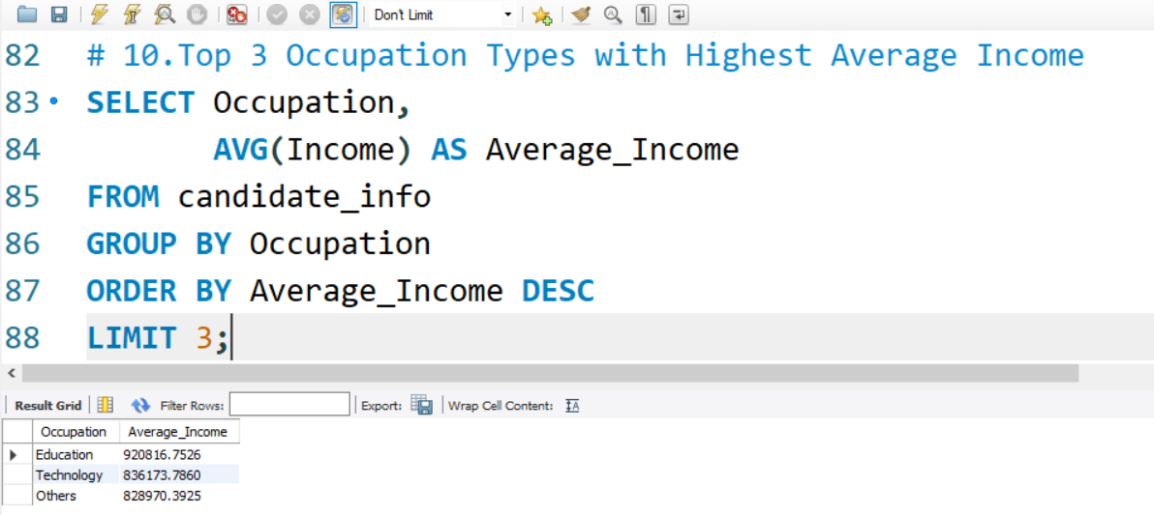
Query 10: top 3 Occupation types with the highest average income
Description: This query calculates the average income for each occupation type.
Analysis: Helps identify the most financially rewarding career paths in the dataset. GROUP BY is used on Occupation, and AVG(Income) computes the mean earnings. ORDER BY DESC sorts the values, and LIMIT 3 picks the top results. This is useful for career recommendations or targeting profitable sectors.
Output: Top 3 occupations : Education, technology and others.
Education has the highest income : RS- 920,816.75.

Slide 13
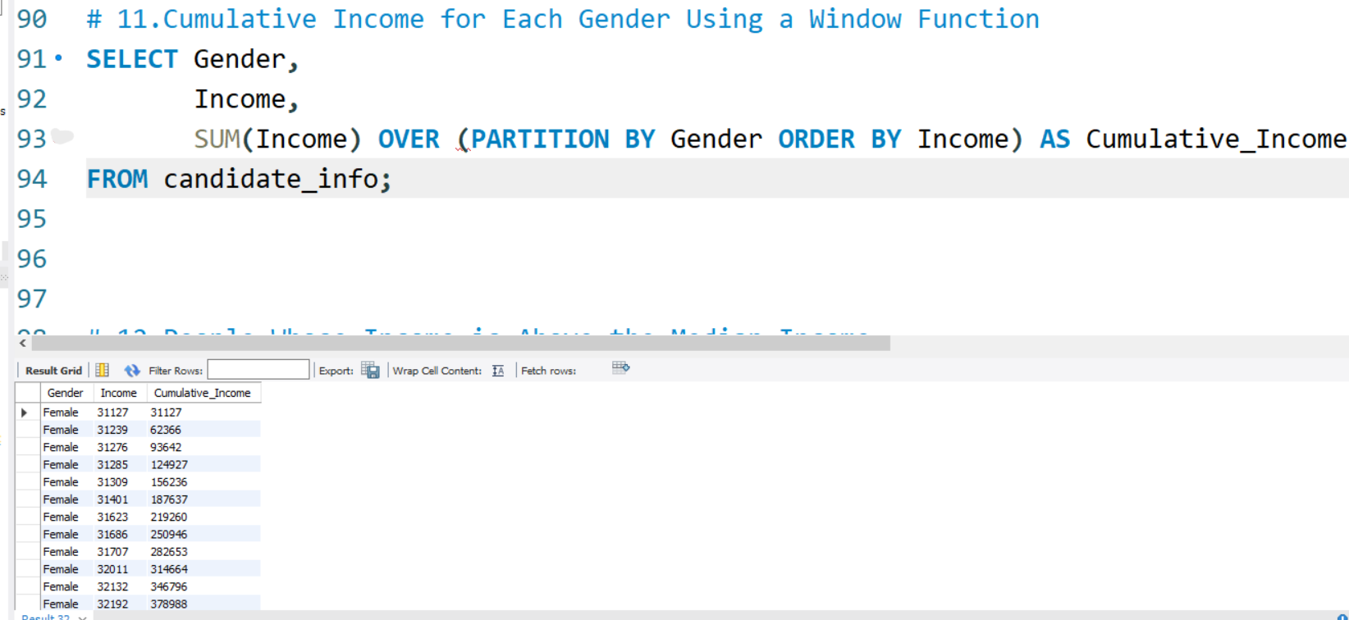
Query 11: window function to calculate the cumulative income for each Gender
Description: This query uses the SUM() window function to calculate cumulative income for each gender. The results are ordered by income within each gender group.
Analysis: Reveals how income accumulates progressively within male and female groups. Uses PARTITION BY Gender to isolate genders and ORDER BY Income for sorting. Helpful for detecting income inequality or understanding distribution trends. Visualizing this can show earnings progression curves by gender.
Output: Females with lowest income starts from Rs-31,127.
Males with lowest income starts from Rs-31,044.

Slide 14
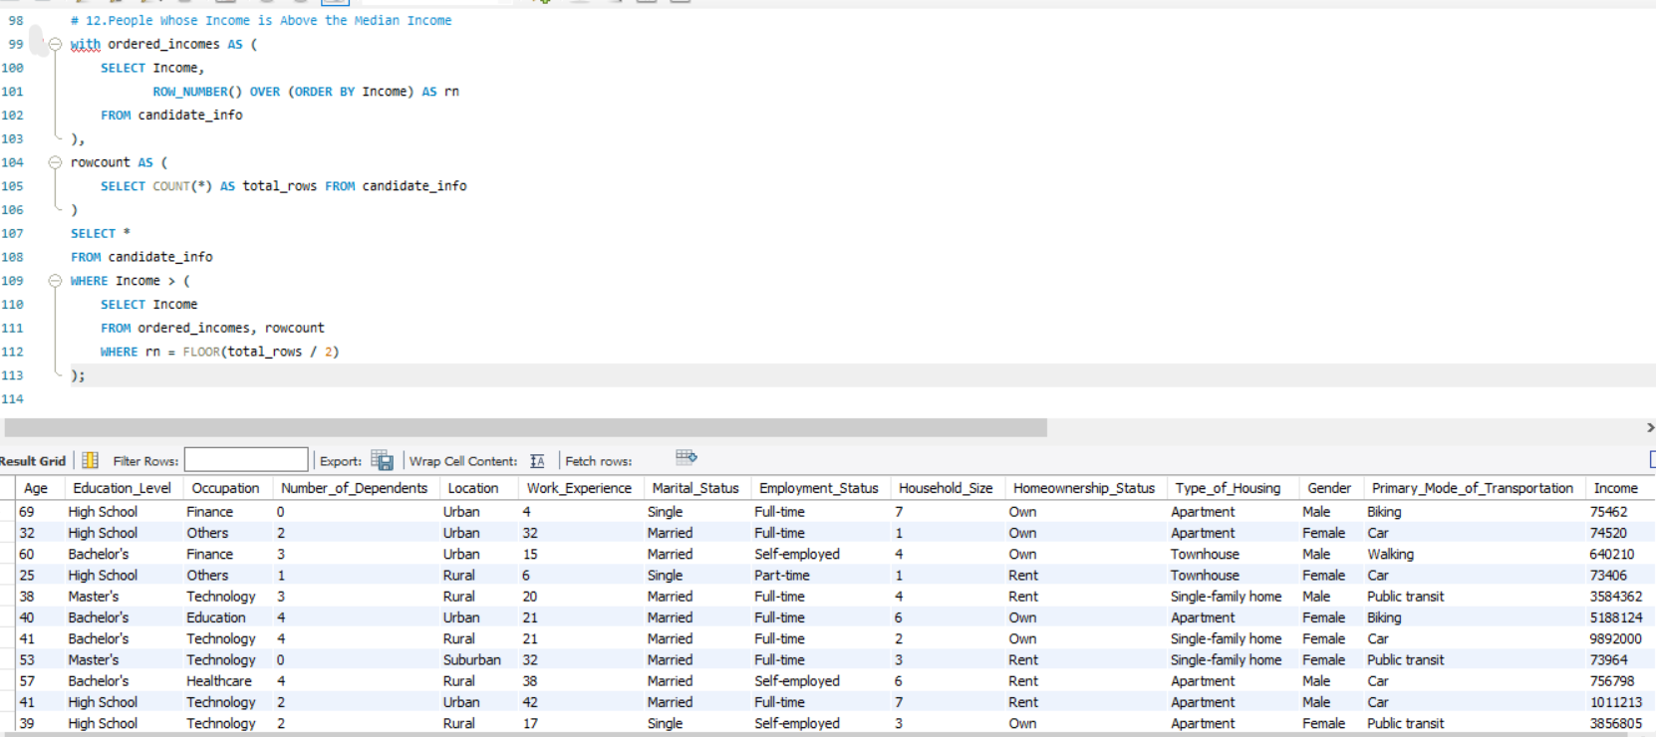
Query 12: the people whose income is above the median income for the dataset
Description: This query identifies individuals whose income is greater than the dataset’s median income. It uses a WITH clause to calculate the median dynamically via row numbers.
Analysis: Filters out the top 50% of income earners for focused analysis. Useful for profiling higher earners, loan eligibility, or premium marketing. Median is calculated by ordering incomes and using FLOOR(total_rows / 2).This method avoids using aggregate functions unsupported in some SQL versions.
Output: Returns all rows where income exceeds the dataset’s median value.
Ideal for analyzing behavior and traits of financially well- off candidates.

Slide 15
Conclusion
This project enabled a thorough exploration of customer demographics, income levels, and lifestyle patterns using SQL. By querying the data, I uncovered insights into how factors like education, employment, and housing relate to financial outcomes. The results reveal key trends in gender distribution, urban wealth concentration, and occupational income. These insights can be applied in real-world scenarios such as strategic marketing, product targeting, and policy formulation.

Slide 16
THANK YOU

